Slide 1
Lecture 15 I/O Devices Manya Gidwani

Slide 2
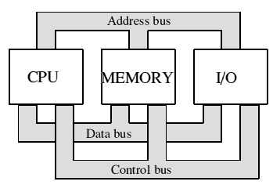
Basic structure of a computer system:
The computer is useless without some kind of interface to to the outside world.

Slide 3
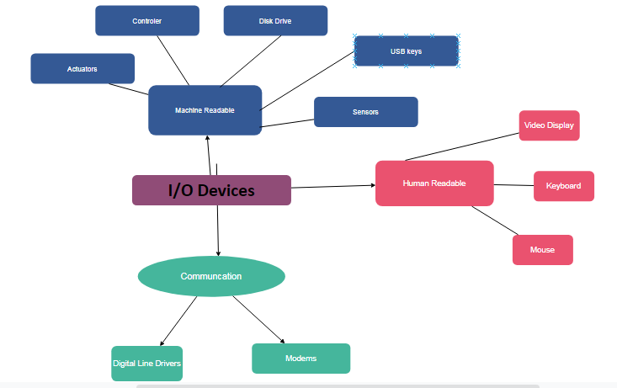
Concept Map Of I/O devices

Slide 4
Differences in I/O Devices
Devices differ in a number of areas
Data Rate
Application
Complexity of Control
Unit of Transfer
Data Representation
Error Conditions
Organization Of I/O Functions
Techniques for performing I/O

Slide 5
Categories of I/O Devices
Difficult area of OS design
Difficult to develop a consistent solution due to a wide variety of devices and applications
Three Categories:
Human readable
Machine readable
Communications

Slide 6
Human readable
Devices used to communicate with the user
Printers and terminals
Video display
Keyboard
Mouse etc
Notes:
Suitable for communicating with the computer user.
Examples include printers and terminals, the latter consisting of video display, keyboard, and perhaps other devices such as a mouse.

Slide 7
Machine readable
Used to communicate with electronic equipment
Disk drives
USB keys
Sensors
Controllers
Actuators
Notes:
Suitable for communicating with electronic equipment.
Examples are disk drives, USB keys, sensors, controllers, and actuators.

Slide 8
Communication
Used to communicate with remote devices
Digital line drivers
Modems
Notes:
Suitable for communicating with remote devices.
Examples are digital line drivers and modems.

Slide 9
Differences in I/O Devices
Devices differ in a number of areas
Data Rate
Application
Complexity of Control
Unit of Transfer
Data Representation
Error Conditions
Notes:
Each of these are covered in subsequent slides
This diversity makes a uniform and consistent approach to I/O, both from the point of view of the operating system and from the point of view of user processes, difficult to achieve.

Slide 10
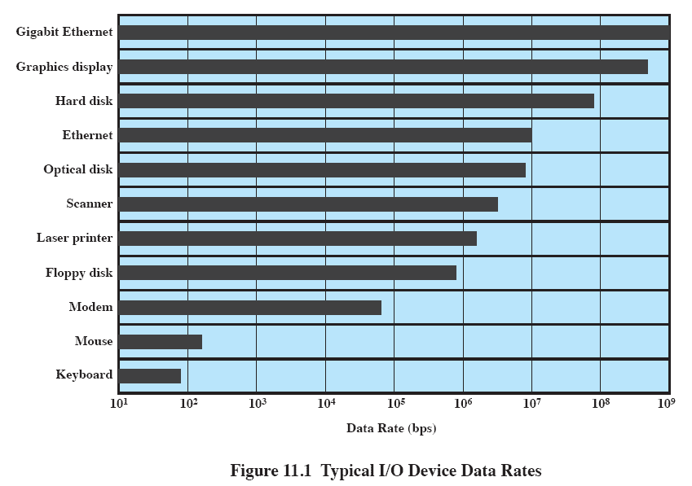
Data Rate
May be massive difference between the data transfer rates of devices
Notes:
There may be differences of several orders of magnitude between the data transfer rates.

Slide 11
Application
Disk used to store files requires file management software
Disk used to store virtual memory pages needs special hardware and software to support it
Terminal used by system administrator may have a higher priority
Notes:
The use to which a device is put has an influence on the software and policies in the operating system and supporting utilities.
Examples:
disk used for files requires the support of file management software.
disk used as a backing store for pages in a virtual memory scheme depends on the use of virtual memory hardware and software.
These applications have an impact on disk scheduling algorithms.
Another example, a terminal may be used by an ordinary user or a system administrator.
implying different privilege levels and perhaps different priorities in the operating system.

Slide 12
Complexity of control
A printer requires a relatively simple control interface.
A disk is much more complex.
This complexity is filtered to some extent by the complexity of the I/O module that controls the device.
Notes:
A printer requires a relatively simple control interface while a disk is much more complex.
This complexity is filtered to some extent by the complexity of the I/O module that controls the device.

Slide 13
Unit of transfer
Data may be transferred as
a stream of bytes or characters (e.g., terminal I/O)
or in larger blocks (e.g., disk I/O).
Notes:
Data may be transferred as a stream of bytes or characters (e.g., terminal I/O) or in larger blocks (e.g., disk I/O).

Slide 14
Data representation
Different data encoding schemes are used by different devices,
including differences in character code and parity conventions.
Notes:
Different data encoding schemes are used by different devices, including differences in character code and parity conventions.

Slide 15
Error Conditions
The nature of errors differ widely from one device to another.
Aspects include:
the way in which they are reported,
their consequences,
the available range of responses
Notes:
The nature of errors, the way in which they are reported, their consequences, and the available range of responses differ widely from one device to another.

Slide 16
Organization Of I/O Functions
Irrespective of the details of how such devices are connected we can say that all I/O is governed by three basic strategies.

Slide 17
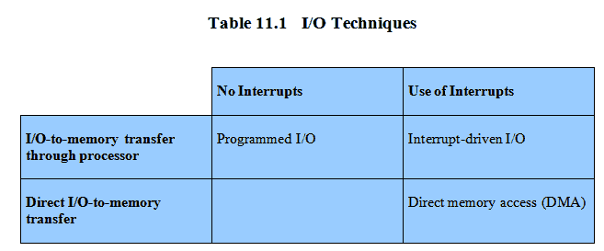
Techniques for performing I/O
Programmed I/O
Interrupt-driven I/O
Direct memory access (DMA)
Notes:
From section 1.7
Programmed I/O:
Processor issues an I/O command, on behalf of a process, to an I/O module;
that process then busy waits for the operation to be completed before proceeding.
Interrupt-driven I/O:
Processor issues an I/O command on behalf of a process.
If the I/O instruction from the process is nonblocking, then the processor continues to execute instructions from the process that issued the I/O command.
If the I/O instruction is blocking, then the next instruction that the processor executes is from the OS, which will put the current process in a blocked state and schedule another process.
Direct memory access (DMA):
A DMA module controls the exchange of data between main memory and an I/O module.
The processor sends a request for the transfer of a block of data to the DMA module and is interrupted only after the entire block has been transferred.
Table 11.1 indicates the relationship among these three techniques.

Slide 18
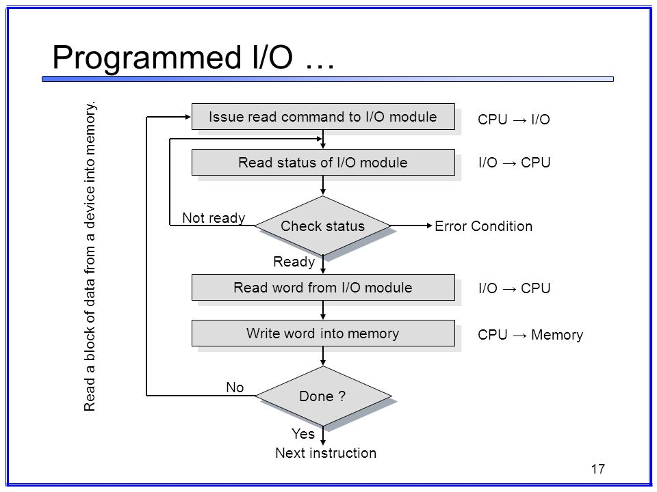
Programmed I/O
In programmed I/O all data transfers between the computer system and external devices are completely controlled by the computer program.
vantages | - simple to implement
 | - very little hardware support
Disadvantages | - busy waiting
 | - ties up CPU for long period with no useful work

Slide 19
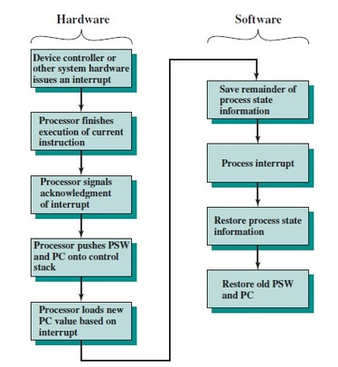
Interrupt-driven I/O
Interrupt I/O is a way of controlling input/output activity whereby a peripheral or terminal that needs to make or receive a data transfer sends a signal.
This will cause a program interrupt to be set.
Advantages | - fast
 | - efficient
Disadvantages | - can be tricky to write if using a low level language
 | - can be tough to get various pieces to work well together
 | - usually done by the hardware manufacturer / OS maker, e.g. Microsoft

Slide 20
Evolution of the I/O Function
Processor directly controls a peripheral device
Controller or I/O module is added
Processor uses programmed I/O without interrupts
Processor does not need to handle details of external devices
Notes:
The processor directly controls a peripheral device.
This is seen in simple microprocessor-controlled devices.
A controller or I/O module is added.
The processor uses programmed I/O without interrupts.
With this step, the processor becomes somewhat divorced from the specific details of external device interfaces.

Slide 21
Evolution of the I/O Function cont…
Controller or I/O module with interrupts
Efficiency improves as processor does not spend time waiting for an I/O operation to be performed
Direct Memory Access
Blocks of data are moved into memory without involving the processor
Processor involved at beginning and end only
Notes:
3. Now interrupts are employed.
The processor need not spend time waiting for an I/O operation to be performed, thus increasing efficiency.
4. The I/O module is given direct control of memory via DMA.
It can now move a block of data to or from memory without involving the processor, except at the beginning and end of the transfer.

Slide 22
Evolution of the I/O Function cont…
I/O module is a separate processor
CPU directs the I/O processor to execute an I/O program in main memory.
I/O processor
I/O module has its own local memory
Commonly used to control communications with interactive terminals
Notes:
5. I/O module is enhanced to become a separate processor, with a specialized instruction set tailored for I/O.
CPU directs the I/O processor to execute an I/O program in main memory.
The I/O processor fetches and executes these instructions without processor intervention.
Allowing the processor to specify a sequence of I/O activities and to be interrupted only when the entire sequence has been performed.
6. The I/O module has a local memory of its own and is, in fact, a computer in its own right.
A large set of I/O devices can be controlled, with minimal processor involvement.
Commonly used to control communications with interactive terminals. The I/O processor takes care of most of the tasks involved in controlling the terminals.

Slide 23
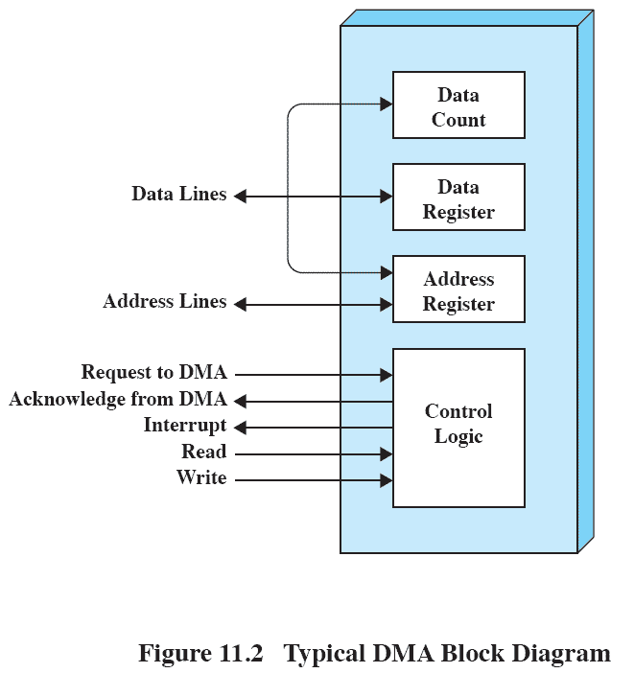
Direct Memory Address
Processor delegates I/O operation to the DMA module
DMA module transfers data directly to or from memory
When complete, DMA module sends an interrupt signal to the processor

Slide 24
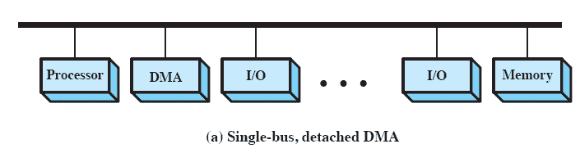
DMA Configurations: Single Bus
DMA can be configured in several ways
Shown here, all modules share the same system bus
Notes:
The DMA mechanism can be configured in a variety of ways.
Some possibilities are shown here In the first example, all modules share the same system bus.
The DMA module, acting as a surrogate processor, uses programmed I/O to exchange data between memory and an I/O module through the DMA module.
This is clearly inefficient: As with processor-controlled programmed I/O, each transfer of a word consumes two bus cycles (transfer request followed by transfer).

Slide 25
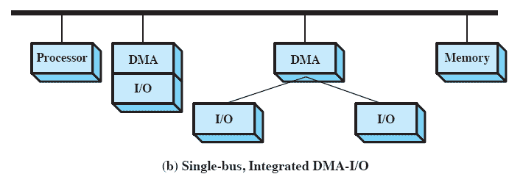
DMA Configurations: Integrated DMA & I/O
Direct Path between DMA and I/O modules
This substantially cuts the required bus cycles
Notes:
The number of required bus cycles can be cut substantially by integrating the DMA and I/O functions.
This means that there is a path between the DMA module and one or more I/O modules that does not include the system bus.
The DMA logic may actually be a part of an I/O module, or it may be a separate module that controls one or more I/O modules.

Slide 26
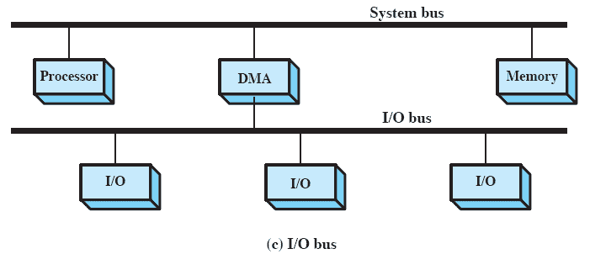
DMA Configurations: I/O Bus
Reduces the number of I/O interfaces in the DMA module
Notes:
This concept can be taken one step further by connecting I/O modules to the DMA module using an I/O bus
This reduces the number of I/O interfaces in the DMA module to one and provides for an easily expandable configuration.
In all of these cases the system bus that the DMA module shares with the processor and main memory is used by the DMA module only to exchange data with memory and to exchange control signals with the processor.
The exchange of data between the DMA and I/O modules takes place off the system bus.

Slide 27
Advantages & Disadvantages of DMA
Advantages | - allows a peripheral device to read from/write to memory without going through the CPU
 | - allows for faster processing since the processor can be working on something else while the peripheral can be populating memory
Disadvantages | - requires a DMA controller to carry out the operation, which increases the cost of the system
 | - cache coherence problems

Slide 28
Thank U

